Slide 1
BOLT Machine Learning Task

Slide 2
Machine Learning
… can open up a whole world of untapped potential
Find patterns and make sense out of even larger and more complex data sets
Predict business outcomes and recommend next-best actions
Turn unstructured data into actions
…. and more

Slide 3

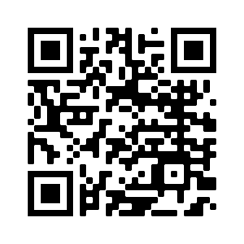
Celonis Online Training
Access in three steps:
Click the link or scan the QR code.
Sign up as „Academic“ user.
Open your E-Mails and click the confirmation link.
Enroll in the „Celonis Machine Learning“ course
Academic
https://www.celonis.com/lms/signup

Slide 4
Free Text Matching
Pain point
Free text orders in internal tool for indirect purchases of products & services cost time and working hours
A greater amount of free text orders could have been found in the catalogue!
Problem description
Identification of free text PRs that matches with items in catalogue
Solution
Create a ML algorithm that searches for past catalogue orders that have high similarity to the free text order
Execution
Indirect procurement buyers have an inbox that lists all matches
PR buyers can choose from several listed catalogue items coming with similarity index
Rejection of free text PRs in Celonis Action Engine with automatic notification for employee
Notes:
Example:
One free text in PR takes appx. 15 minutes to match to the right item on average
100,000 free text PRS per Year = 25,000 hours per year only for matching
You can save time by automating processes by removing effort and reducing costs by recommending similar items

Slide 5
Create your Celonis Machine
Learning App
IN THREE STEPS
Upload data and create a data model.
Configure your ML app.
Put your ML app in operation.
Before you start!
Make sure you have access to the online training
Log in to the online training platform lms.celonis.com
Enroll in the Celonis Machine Learning course

Slide 6
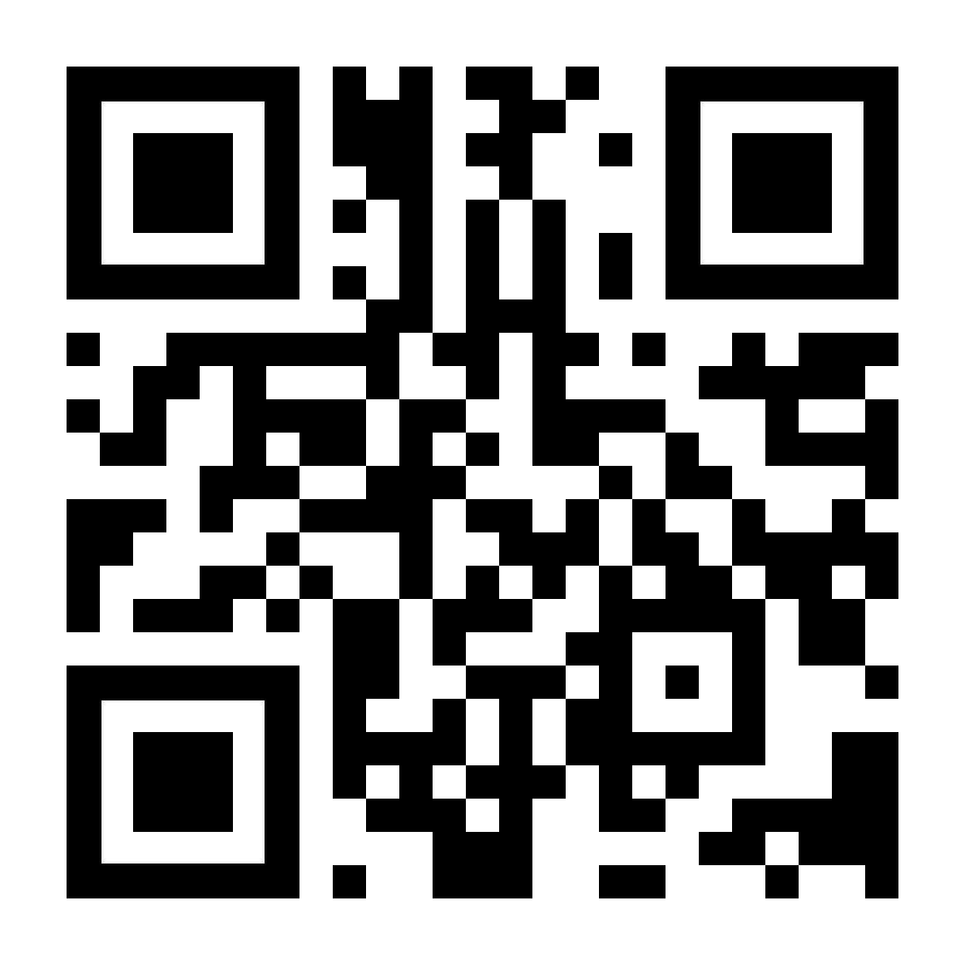
Upload data and create a data model.
Download the .csv files required for the Data Models.
Access your Personal Training Environment.
Create a new Data Pool in the Event Collection.
Create two new Data Models within the Data Pool.
Download the Data tables
https://bit.ly/P2Pdata

Slide 7

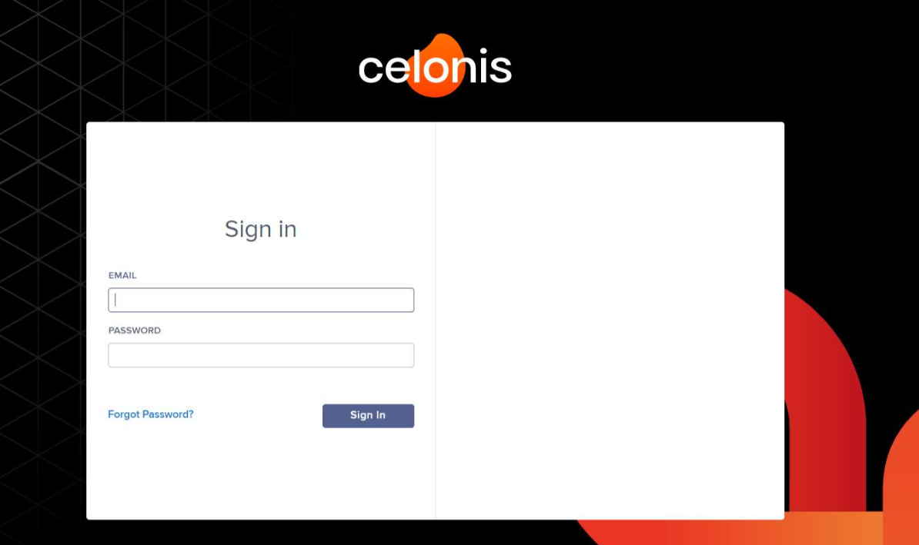
Upload data and create a data model.
Download the .csv files required for the Data Models.
Access your Personal Training Environment.
Create a new Data Pool in the Event Collection.
Create two new Data Models within the Data Pool.
Access your Personal Training Environment
https://[UNIQUE URL].training.celonis.cloud/

Slide 8

Upload data and create a data model.
Download the .csv files required for the Data Models.
Access your Personal Training Environment.
Create a new Data Pool in the Event Collection.
Create two new Data Models within the Data Pool.
In your top bar, go to Event Collection and create a data pool.

Slide 9
Upload data and create a data model.
Download the .csv files required for the Data Models.
Access your Personal Training Environment.
Create a new Data Pool in the Event Collection.
Create two new Data Models within the Data Pool.
Create a data model and connect the foreign keys.
EKPO : EBAN | MANDT, EBELN, EBELP
EKKO : EKPO | MANDT, EBELN
EKPO: _CEL_P2P_ACTIVITIES | _CASE_KEY
Give the tables shorter alias names.

Slide 10
Upload data and create a data model.
Download the .csv files required for the Data Models.
Access your Personal Training Environment.
Create a new Data Pool in the Event Collection.
Create two new Data Models within the Data Pool.
You did it! ☺

Slide 11
2. Configure your ML app.
3. Put your ML app in operation.
Go to the Celonis Machine Learning course.
Start the training and go directly to the Free Text Matching section.
Start with the Step by step configuration and continue the training sections Putting it into operation as well.

